Slide 1
Linux/Unix
Siddhant

Slide 2
Agenda
Operating System
Unix
Linux
Commands

Slide 3
Operating System
Manages Computer Hardware and applications
Windows
Unix
Linux
Amoeba OS
Solaris

Slide 4
Unix System V
Multi-user
Multi-tasking
Varieties:Sun Solaris,Linux,Mac OSX

Slide 5
Linux
Developed by Linus Torvalds
Developed on Minix
Includes features from both BSD and System V
Open Source
Free
GPL Agreement by GNU
Wide variety of tools:graphical,word processing,server etc.

Slide 6
Linux(Cont...)
Conforms to POSIX mostly
Support lot of processor architecture
Support emulators
Multiprocessor Compatible
Kernel written in C and Assembly

Slide 7
Linux(Cont...)
Its everywhere
Washing machine,TV,Laptops,Servers

Slide 8
Advantage of using Linux
Open-source
Free
Stable
Secure
Supports many Hardware
Freedom

Slide 9
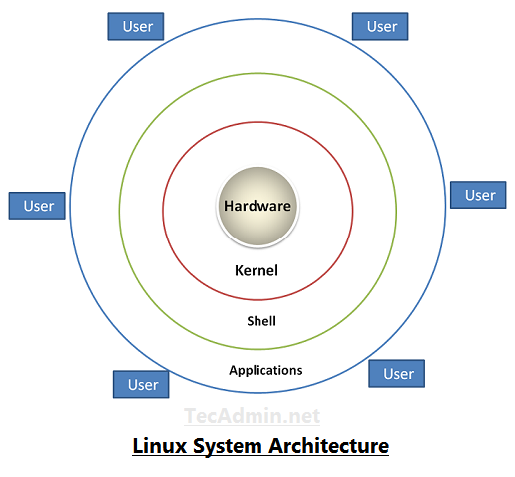

Slide 10
Distributions
Debian
Redhat
Opensuse
Arch
Slackware
List is very long

Slide 11
Filesystem
Store data in organized manner
Ext4
Btrfs
Jfs
Xfs
List is very long

Slide 12
Shell
Bash
Zsh
Ksh
Fish

Slide 13
Basic Commands
ls:Listing Content
mkdir:Create directory
cat:Show files on Terminal
touch:Create empty file
cp:Copy
mv:move
Lets check on terminal

Slide 14
Text Editors
Command line
Nano
Vi
Graphical User Interface
Gedit
Pluma
Featherpad
Kate

Slide 15
Compression & Decompression
tar
Syntax to compress file or directory
tar -cvf <compressed filename> <directory/file>
Syntax to decompress file
tar -xvf <compressed filename>
-j for bzip2
-J for xz
-z for gzip

Slide 16
File Permissions
Three permissions
Read
Write
Executable
Three categories
Owner
Group
Other
Command to change permissions
chmod

Slide 17
File Permissions(Cont...)
Numeric Representation
Read:4
Write:2
Execute:1

Slide 18
Root Privilege
Command
sudo
su

Slide 19
User Management
Command
useradd
Syntax: useradd [options] username
Edits /etc/passwd,/etc/shadow,/etc/group and /etc/gshadow
Command to change password
passwd

Slide 20
User Management(Cont...)
sid:x:1000:1000:sid:/home/sid:/bin/bash
Username
Password
UID
GID
User Info
Home directory
Shell

Slide 21
User management(Cont...)
Create user with different home directory
useradd -d /home/neha sid
Create user with specific UID
useradd -u 999 sid
Create user with specific GID
useradd -g 999 sid
Add user to multiple groups
useradd -G sudoers,avahi sid
Create user without home directory
useradd -M sid

Slide 22
User management(Cont…)
Create user with expiry date
useradd -e 2020-12-31 sid
Use chage command to check age:chage -l sid
Create user with password expiry date
useradd -f 45 sid
Create user with user info
useradd -c “Siddhant verma” sid
Create user with custom shell
useradd -s /bin/fish sid

